Slide 1
Painty studios ltd
London Art Gallery Location

Slide 2
introduction
Painty Studio Ltd. are looking to expand and set-up new art gallery in London.
Previous experience is in Finland and they want to select the best London Borough to open – targeting the local population that might be most interested in the arts, and therefore the most profitable.
The data science team have been tasked with recommending a Borough to the CEO.

Slide 3
Data
Budget is low, so the data science team will using publically available data. They need data with geographical location as well as understanding the venues that currently exist in each area.
The sources for this data are:
Wikipedia: List of London Boroughs and population size
Foursquare: information on number and type of venues in each borough

Slide 4
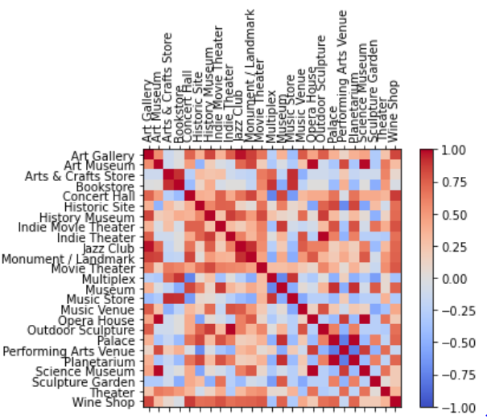
Methodology
The methodology was as follows:
Step 1: Gather the data from each source
Step 2: Merge data from each source
Step 3: Feature analysis – understand available data and correlations, use this to select appropriate further steps
Step 4: Grouping Boroughs via clustering machine learning algorithm
Step 5: Cluster Analysis to recommend most appropriate Borough to set up gallery
Feature analysis example: Correlation matrix between existing artistic venues in London

Slide 5
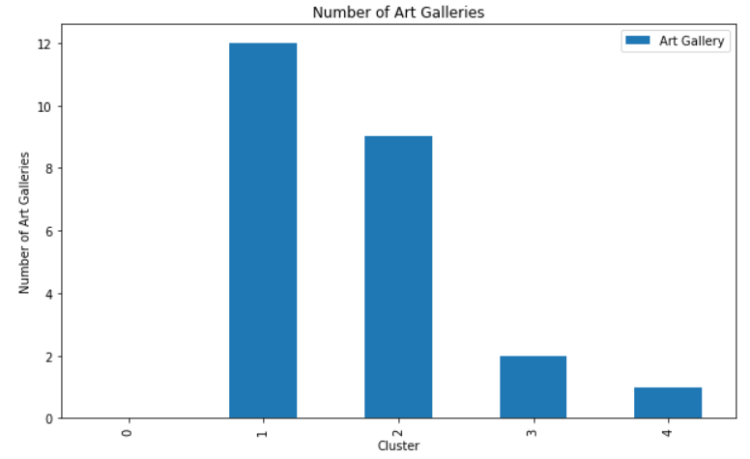
OBSERVATIONS
After clustering algorithm was applied, ‘Cluster 1’ showed promise.
Boroughs in cluster 1 contained the highest number of artistic venues such as music venues and movie theaters, as well as the art galleries.
Positive indication that population in Cluster 1 Boroughs might be interested in art
Art galleries per cluster (grouping based on k-means algorithm)

Slide 6
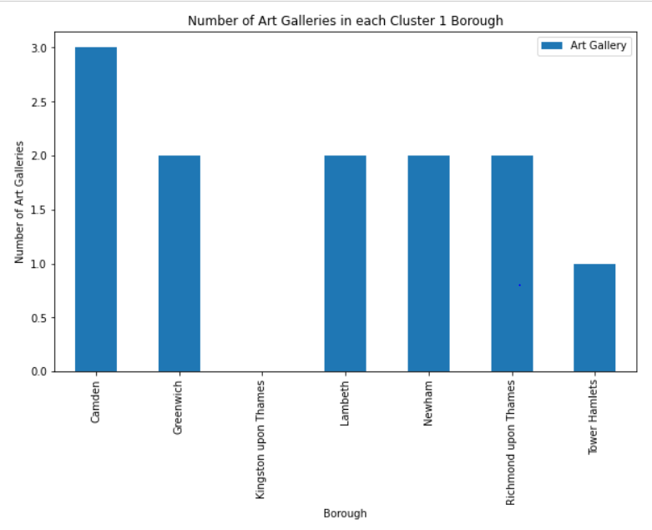
Competitor analysis
Art galleries are very competitive, and so it is best not be to be too close to another venue
Kingston-upon-Thames is the only venue in Cluster 1 that does not already have an art gallery, making it an exciting opportunity to open one as the population have been highlighted as having good potential
Existing art galleries in target cluster

Slide 7
Recommendation
Look for new premises in Kingston-upon-Thames, as this is likely to have a very receptive population to an art gallery and does not have one already
If premises are not available then Tower Hamlets would be interesting, only having one art gallery already.
Perhaps conduct a local street survey in Kingston-upon-Thames to get a firm understanding of interest

